Slide 1
PROJECT REVIEW
ZEROTH LEVEL

Slide 2




OUR TEAM
AJAY DAS K
(CCV19CS002)
RABEEH C
(CCV19CS019)
FATHIMA IRFANA T P
(CCV19CS007)
MUHAMMED FAIS M T
(CCV19CS015)
GROUP NUMBER : 2
GUIDE NAME : NASRIN JUMANA K T

Slide 3
TABLE OF CONTENTS
01
02
03
04
05
Area of project
Facial Emotion Based Song Recommendation System
Enabling Home Automation And Edge Intelligence Over Resource Constraint Iot Devices For Disabled People
Object Tracking In Agriculture
Mutism Aid System

Slide 4
Area of project
01
02
03
IOT
CNN
DEEP LEARNING

Slide 5

01
ENABLING HOME AUTOMATION AND EDGE INTELLIGENCE OVER RESOURCE CONSTRAINT IOT DEVICES FOR DISABLED PEOPLE
PAPER PUBLISHED BY : SCIENCE DIRECT, 2022
Smartphone usage IOT
Convenient, efficient and secure .
Assist the disabled people

Slide 6
ABOUT THE PROJECT
LANGUAGE USED
C#
REQUIRMENTS
WINDOWS 7 OR GREATER , MINIMUM 4 GB RAM ,NODE MCU 8266,IOT ENABLED GADGETS,DISPLAY,POWER SUPPLY,UTILITY GADGETS,GEAR MOTOR , ALEXA/GOOGLE ASSISTANT
EXPECTED TIME SPAN
AROUND 4 MONTHS

Slide 7

02
MUTISM AID SYSTEM
International Journal of Engineering Research & Technology (IJERT)Vol. 11 Issue 05, May-2022
Effective communication
Easier contact
Convert action to voice command

Slide 8
ABOUT THE PROJECT
LANGUAGE USED
python
REQUIRMENTS
WINDOWS 7 OR GREATER , MINIMUM 4 GB RAM , PYTHON EMBEDED ENVIRONMENT, CAMERA SENSOR,YOLO ALGORITHM,SPEAKER.
EXPECTED TIME SPAN
AROUND 5 MONTHS

Slide 9

03
FACIAL EMOTION BASED SONG RECOMMENDATION SYSTEM
International Journal of Engineering Research & Technology (IJERT)Vol. 11 Issue 05, May-2022
More efficient
enlighten mood sophisticatedly
Complete hand free
Daily life application.

Slide 10
ABOUT THE PROJECT
LANGUAGE USED
python
REQUIRMENTS
PYTHON EMBEDED ENVIRONMENT, CAMERA SENSOR,SPEAKER, WINDOWS 7 OR GREATER , MINIMUM 4 GB RAM.
EXPECTED TIME SPAN
AROUND 5 MONTHS

Slide 11
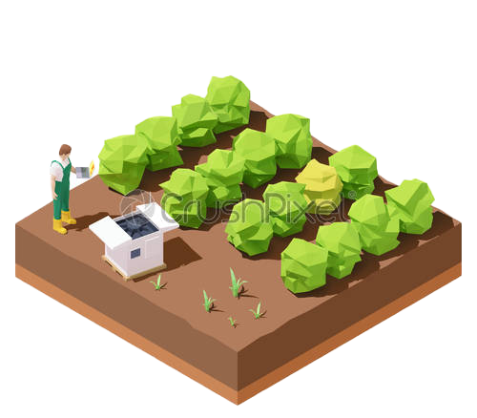
04
OBJECT TRACKING IN AGRICULTURE
Computer Vision and Image Understanding 222 (2022) 103508 C , SCIENCE DIRECT
Secure protection
Remote controlling
More economic.

Slide 12
ABOUT THE PROJECT
LANGUAGE USED
Python,c#
REQUIRMENTS
PYTHON EMBEDED ENVIRONMENT, CAMERA SENSOR,YOLO ALGORITHM,SERVO MOTOR,DEFENCE MECHANISM, WINDOWS 7 OR GREATER , MINIMUM 4 GB RAM.
EXPECTED TIME SPAN
AROUND 5.5 MONTHS

Slide 13
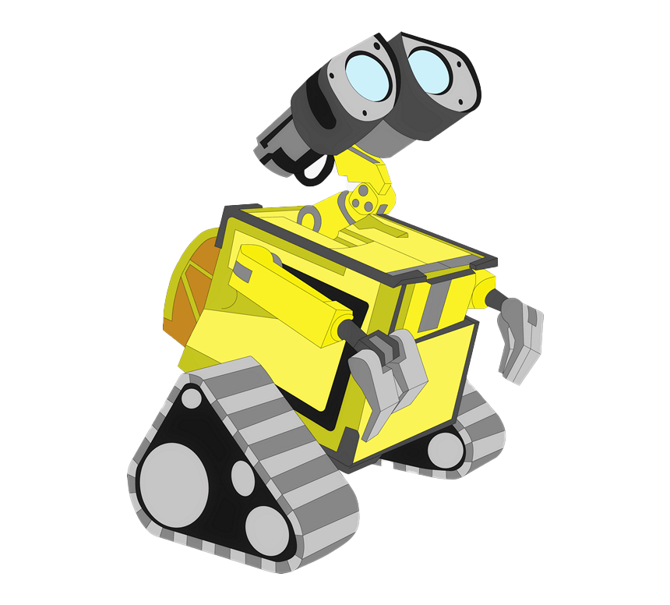
CONCLUSION
THAKS FOR HEARING US , AND THANKS FOR GIVING A OPPURTUNITY TO PRESENT OUT OUR THOUGHTS .
WE LIKES TO CONCLUDE OUR PRESENTATION.

Slide 14
THANKS
HAVE ANY QUESTIONS ?

